Slide 1


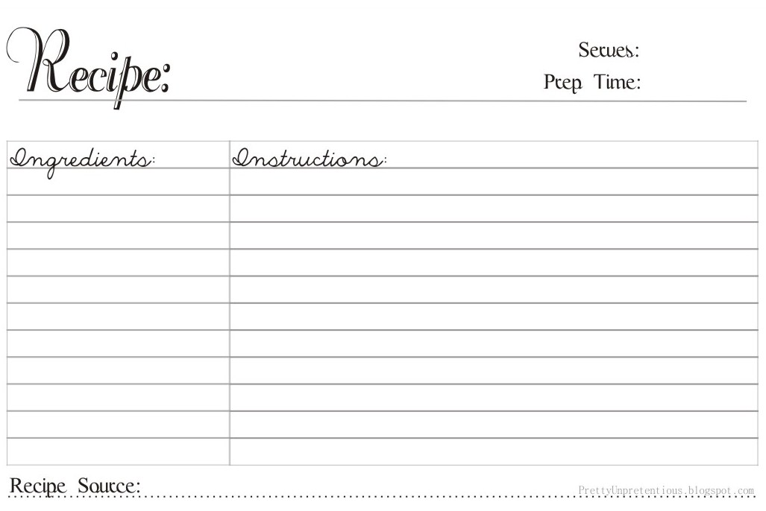
1) The order card
- This is the card to show what the guests have ordered
Burger and chips Cola
3) The Instructions
- This card shows what the players have to do to cook and prep ingredients
2) The Ingredients
- This card shows what ingredients player has to gather
Mince
Tomatoes
Lettuce
Bread (buns)
Mince
Tomatoes
Lettuce
Cook – 3 taps and 3 taps to shape
Chop x5
Chop x 10

